Slide 1

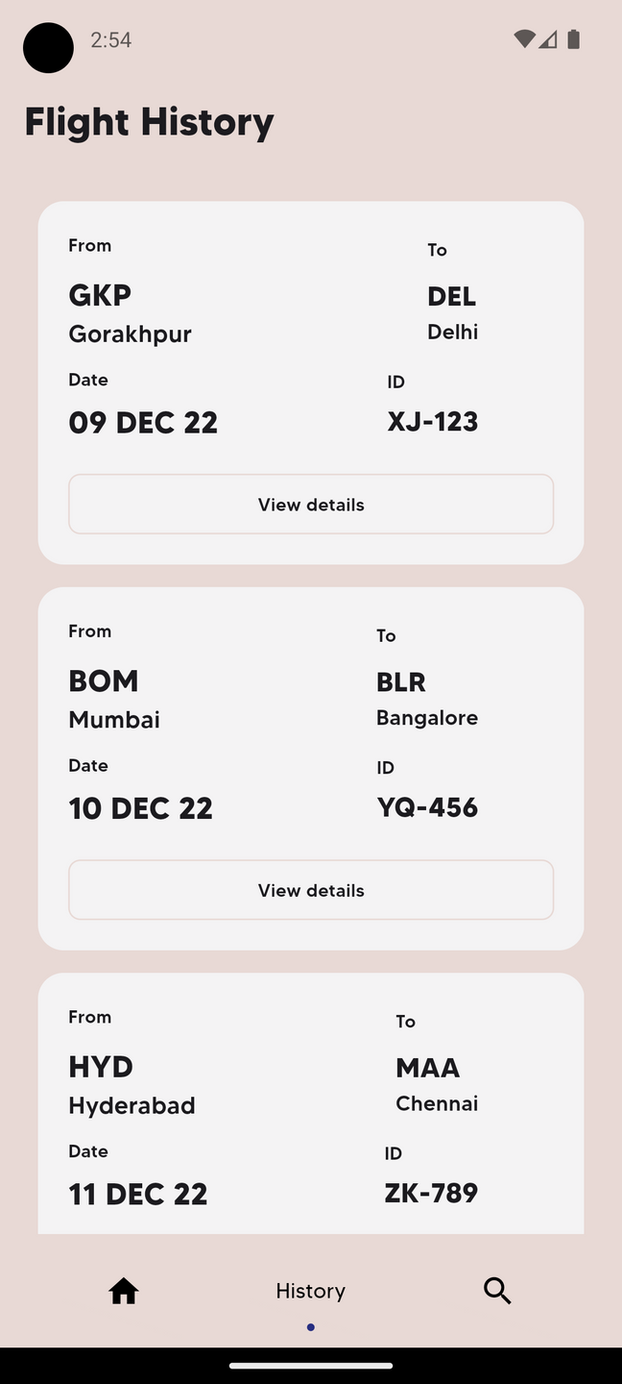
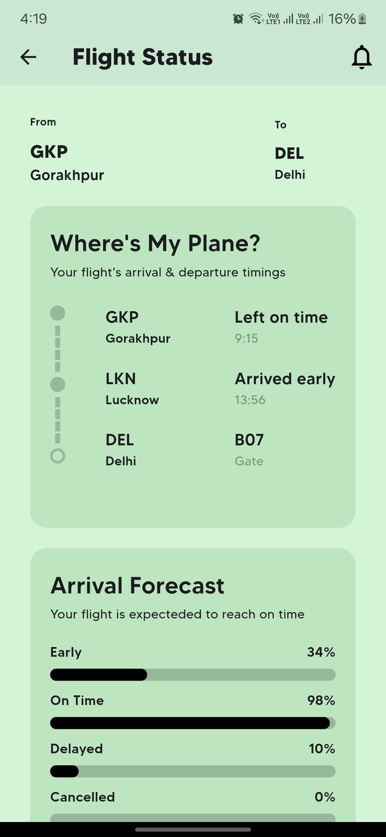
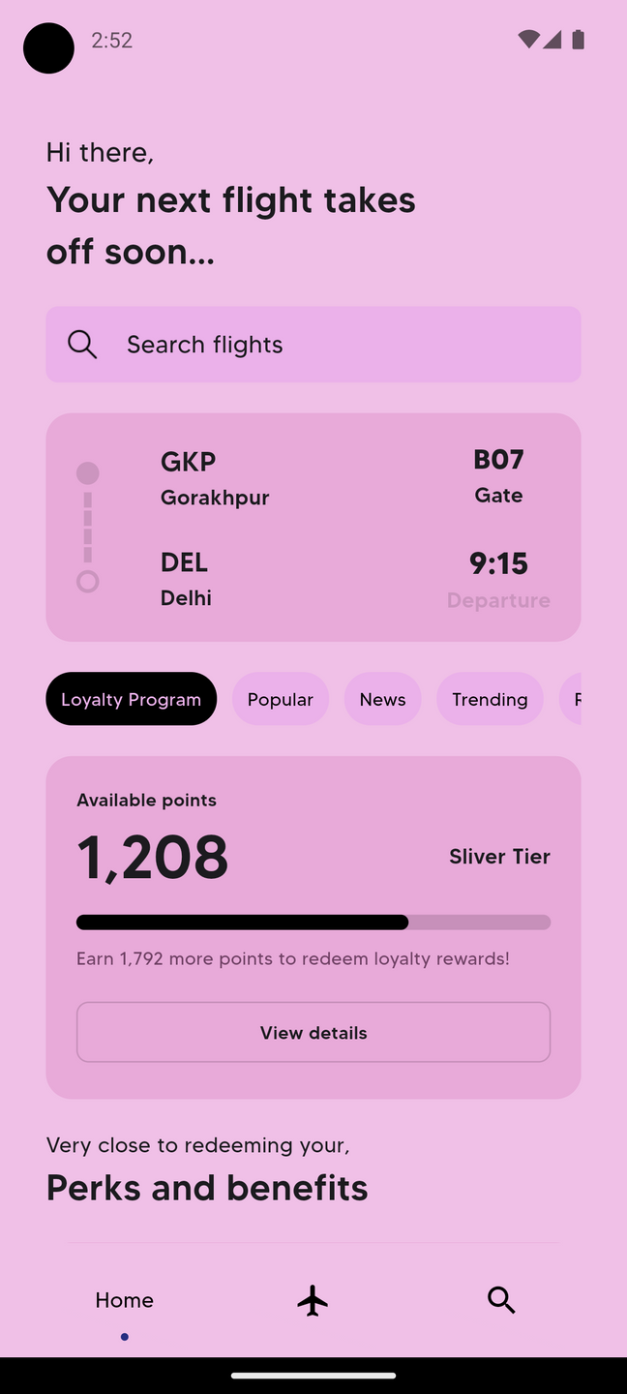
AirNotify
REAL TIME FLIGHT STATUS

Slide 2
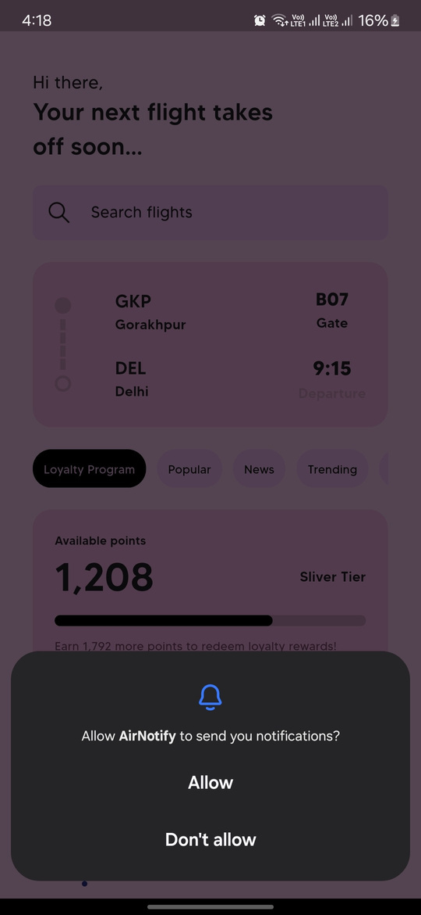
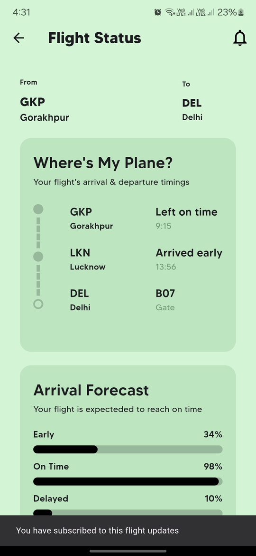
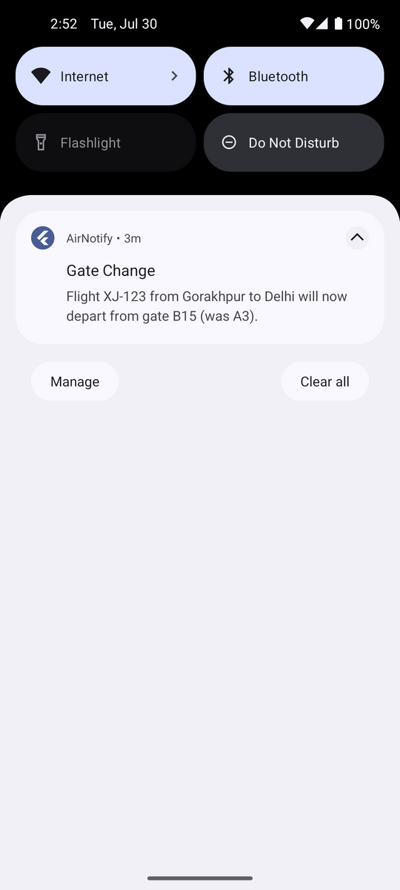
Your Flight, Our Priority
REAL-TIME UPDATES AND NOTIFICATIONS

Slide 3
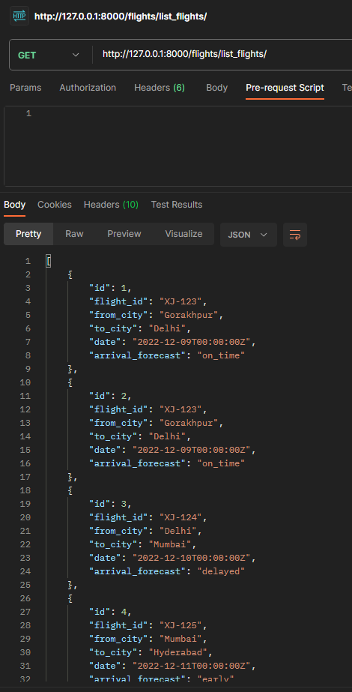
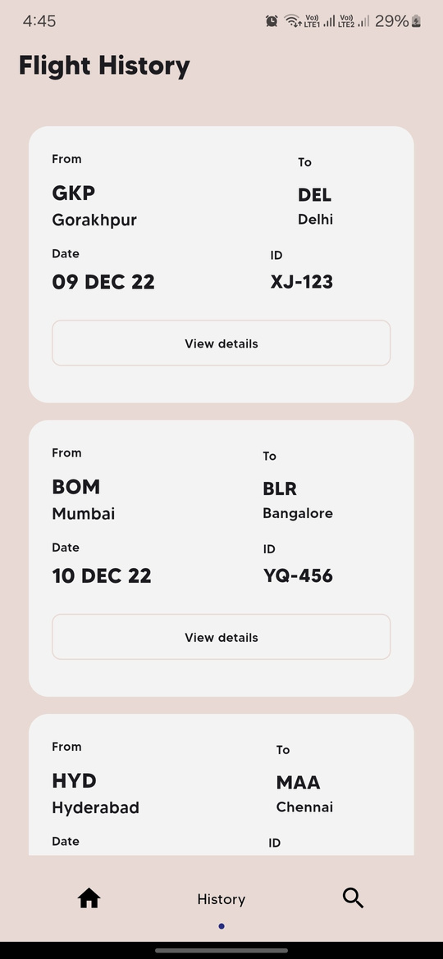
Past Flights, Present Insights
MANAGE YOUR FLIGHT HISTORY SEAMLESSLY.

Slide 4
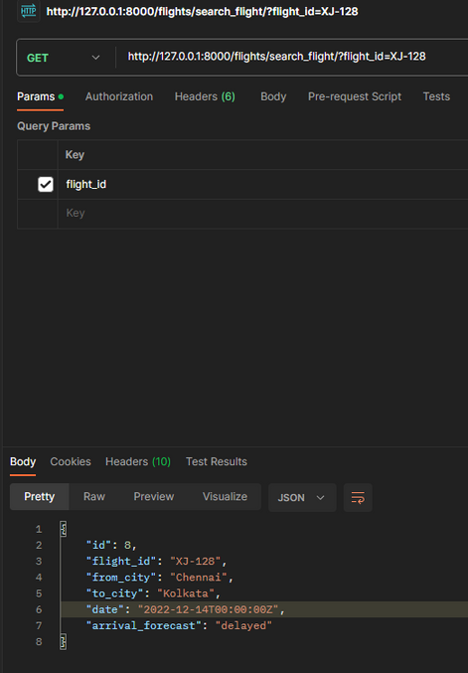
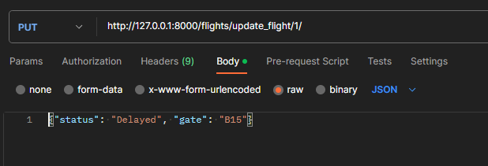
Beyond the Basics
DETAILED FLIGHT INSIGHTS AND FORECASTS BASED ON HISTORY.

Slide 5
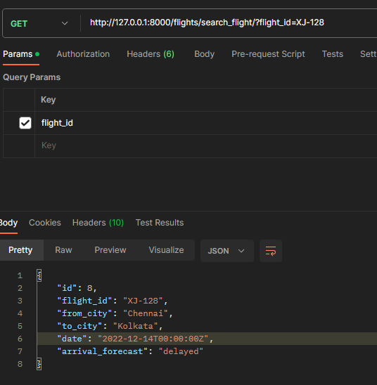
Find Your Flight and Reward Yourself
KEEP TRACK OF YOUR LOEFFORTLESSLY SEARCH FLIGHTS, TRACK LOYALTY POINTS, AND ENJOY GREATER BENEFITS.YALTY POINTS AND ENJOY GREATER BENEFITS.

Slide 6
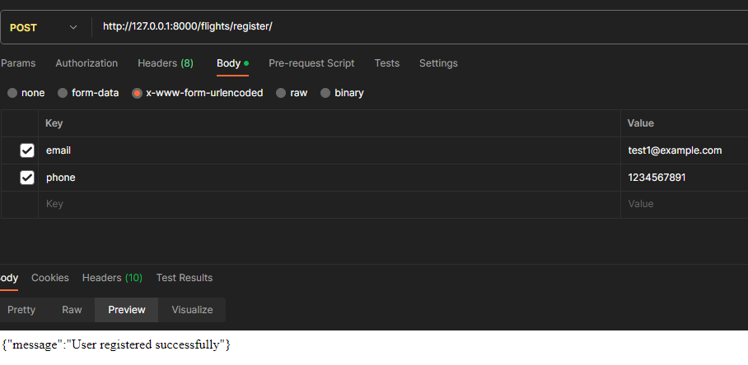
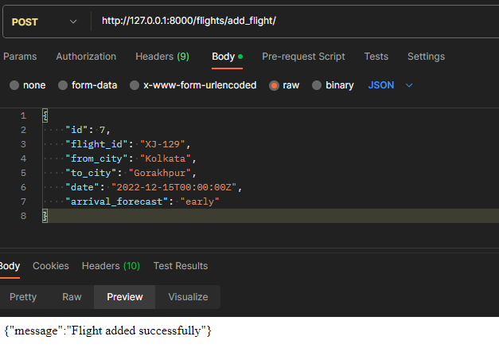
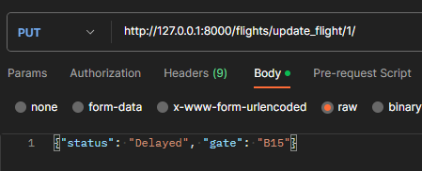
Empower Your Admins:
EASILY ADD, UPDATE, AND MANAGE FLIGHTS AND USERS!

